Slide 1

Linux Learning Workshop
Instructor: Tedley Meralus
Date: 03.13.17

Slide 2


Welcome to the excited world of Linux

Slide 3
What is Linux?

Slide 4
What is Linux?
Linux is the best-known and most-used open source operating system. As an operating system, Linux is software that sits underneath all of the other software on a computer,

Slide 5
What makes Linux different?
Linux also is different from other operating systems in many important ways. Linux is open source software. The code used to create Linux is free and available to the public to view, edit, and—for users with the appropriate skills—to contribute to.

Slide 6
How is Linux Built

Slide 7
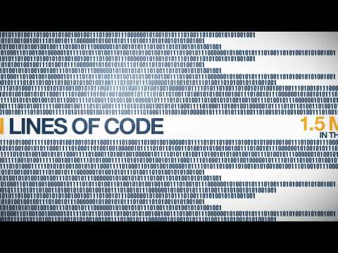

Slide 8


LINUX AT HOME
1. Host a photo album
2. Build a media server
3. Make sweet music
4. Write interactive fiction
5. Secure remote desktops
6. Record a podcast

Slide 9
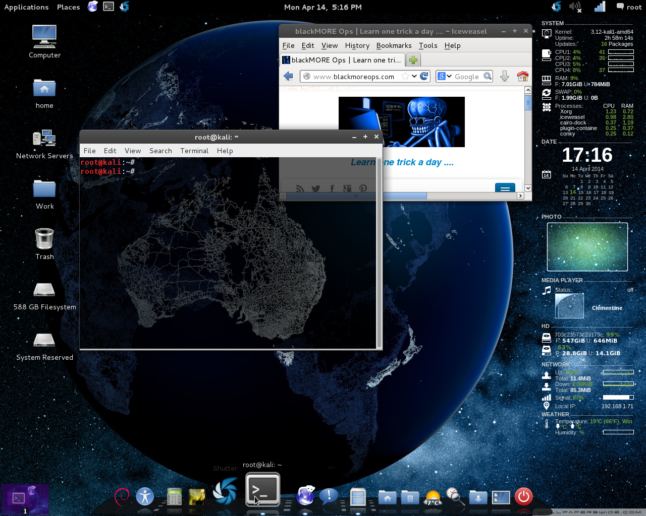
Linux at Home

Slide 10


Linux in the workplace

Slide 11
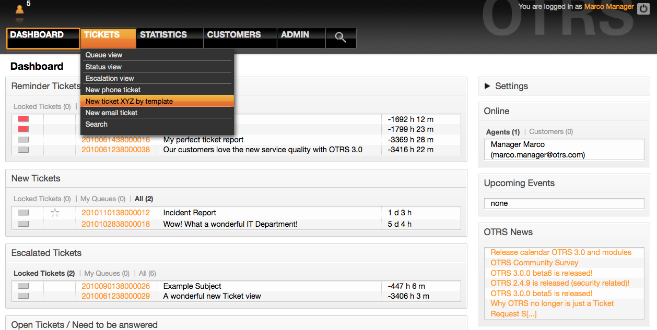
OTRS Ticket Request System

Slide 12

Content Management

Slide 13
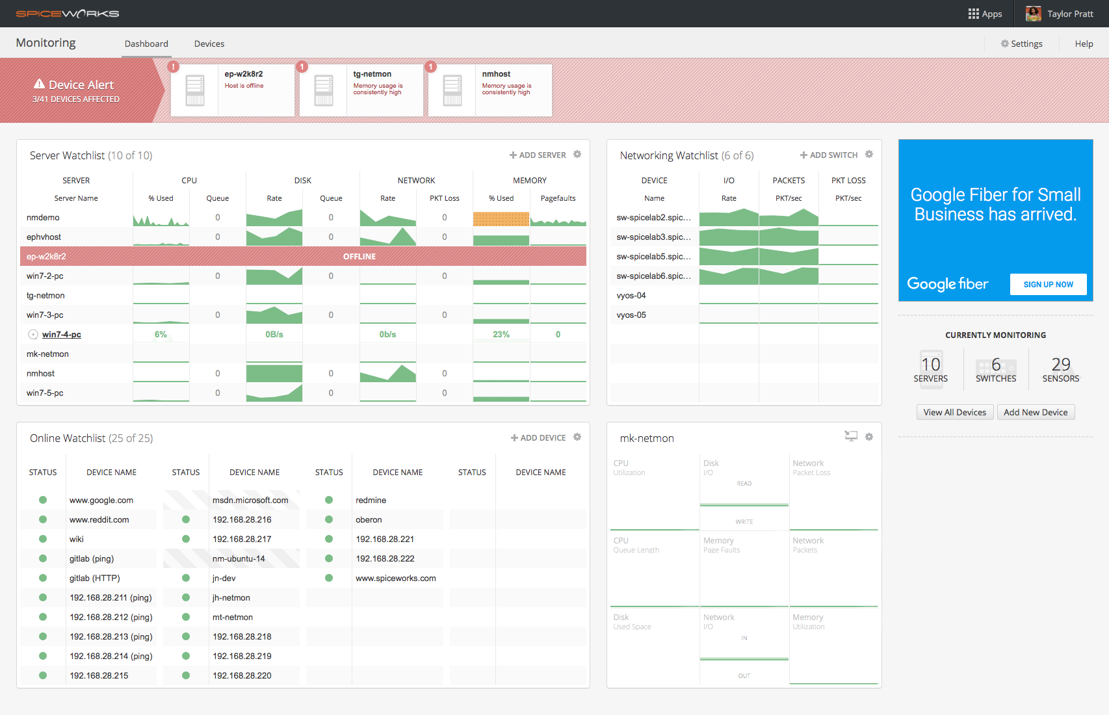
NETWORK BANDWIDTH UTILIZATION

Slide 14
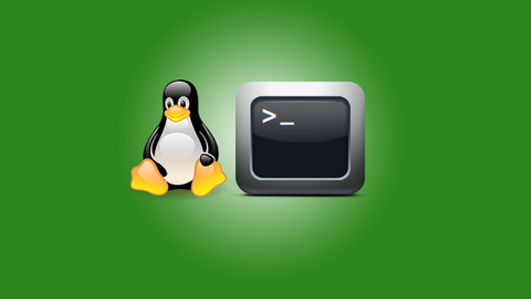
LETS GET STARTED

Slide 15
Logging In
3 ways to connect
Use Ninite Installer to install Putty
https://ninite.com/putty/
Use Google Chrome and SSH Extension
https://chrome.google.com/webstore/detail/secure-shell/pnhechapfaindjhompbnflcldabbghjo?hl=en
Username:
user@ubuntu-ACM-W-LLP port 22
Or
user@45.55.218.37 port 22

Slide 16
What am I working in?
Check whos logged into a server with who
Checking linux with Uname
Check environment with cat /etc/issue
Check environment with cat /etc/*release

Slide 17

Software List

Slide 18

INSTALLING PACKAGES

Slide 19
Package Managers
Operating System | Format | Tool(s)
Debian | .deb | apt, apt-cache, apt-get, dpkg
Ubuntu | .deb | apt, apt-cache, apt-get, dpkg
CentOS | .rpm | yum
Fedora | .rpm | dnf
FreeBSD | Ports, .txz | make, pkg

Slide 20
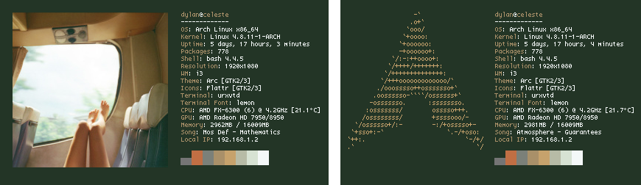
NEOFETCH
Neofetch is a CLI system information tool written in BASH. Neofetch displays information about your system next to an image, your OS logo, or any ascii file of your choice. The main purpose of Neofetch is to be used in screenshots to show other users what OS/Distro you're running, what Theme/Icons you're using and etc.

Slide 21
Installing a packages
PPA:
sudo add-apt-repository ppa:dawidd0811/neofetch
sudo apt update && sudo apt install neofetch
DPGK --list
OUTPUT DPKG List

Slide 22
Outputting a file or command
Output a file >> neofetch.txt
Output Neofetch to new directory >> /home/PUBLIC/neofetch.txt
Create new directory with

Slide 23
Most used and useful commands
MV - move files in from one location to another
LS - list/show files in current directory
RM- remove a file
Dir - directory, or folder in a filesystem
Touch -command to create a file
Pwd - Print working directory
MAN - manual of commands within Unix system
CD - change directory or move within a filesystem
CAT - concatenate, reads a file within a filesystem

Slide 24
ASSIGNMENT
Navigate to PUBLIC Folder
Create folder with first initial and last name ex: tmeralus
Navigate through each folder in Assignment directory
Choose favorite female actress and copy to new directory
Choose favorite song and copy to new directory
Choose favorite movie and copy to new directory
Navigate to user folder
Output each file to make them text files

Slide 25
NEXT WEEK
Bash Scripting
Understanding the Shell
Basic bash scripts
“If you have to do anything twice, it should be automated”

